Slide 1

GluonCV
Deep Learning Toolkit for Computer Vision
https://gluon-cv.mxnet.io/
Muhyun Kim, AI Labs
TeaHyun Kim, ML AoD, Solutions Architect
August 13, 2018
Notes:
https://medium.com/apache-mxnet/gluoncv-deep-learning-toolkit-for-computer-vision-9218a907e8da

Slide 2
Agenda
Computer Vision
GluonCV
Data Augmentation
Transfer Leaning
Data Preparation using RecordIO

Slide 3
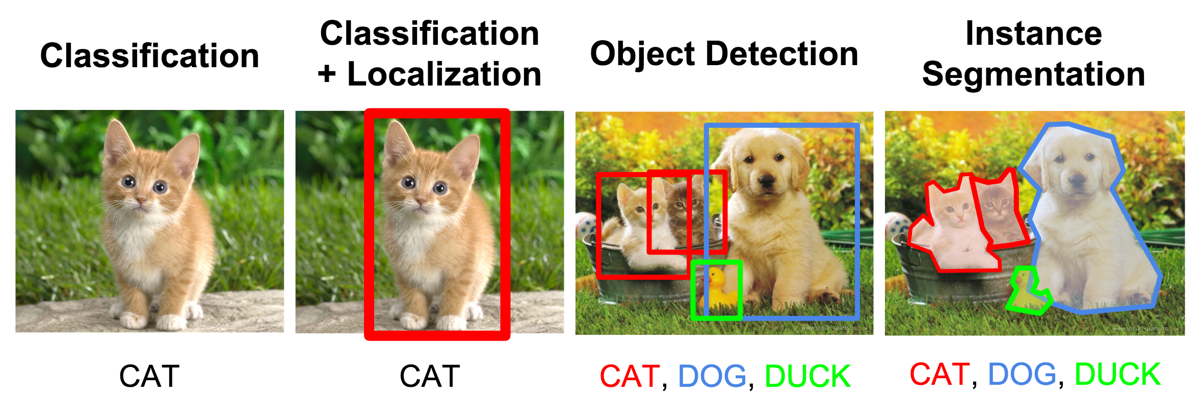
Computer Vision Problems (NOT ALL)

Slide 4
Convolutional Neural Network for Image Classification
Source: https://adeshpande3.github.io/adeshpande3.github.io/A-Beginner's-Guide-To-Understanding-Convolutional-Neural-Networks/

Slide 5
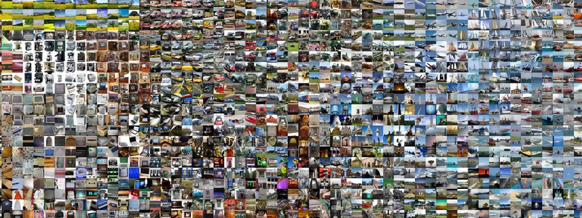
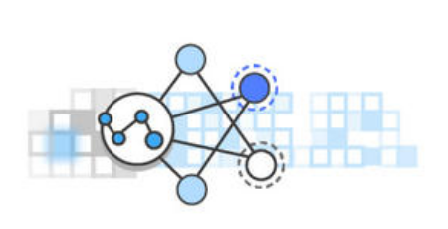
What needed to solve computer vision problems
Training Data
ML Algorithm
Image Credit : http://karpathy.github.io/2014/09/02/what-i-learned-from-competing-against-a-convnet-on-imagenet/

Slide 6
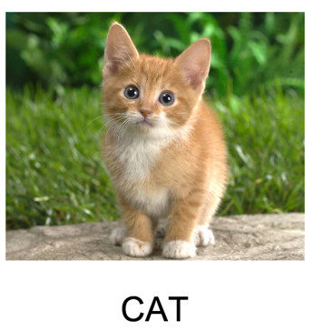
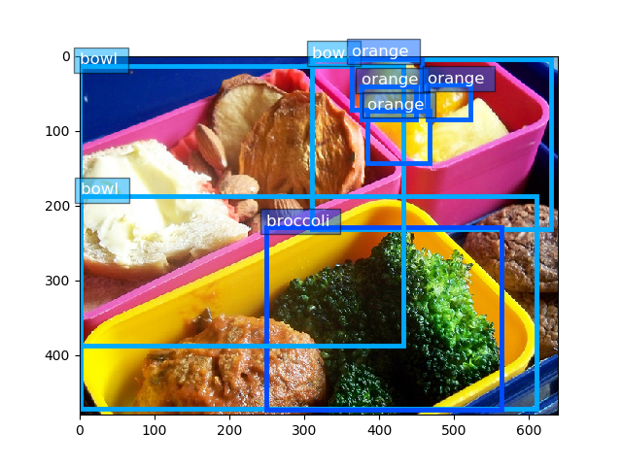
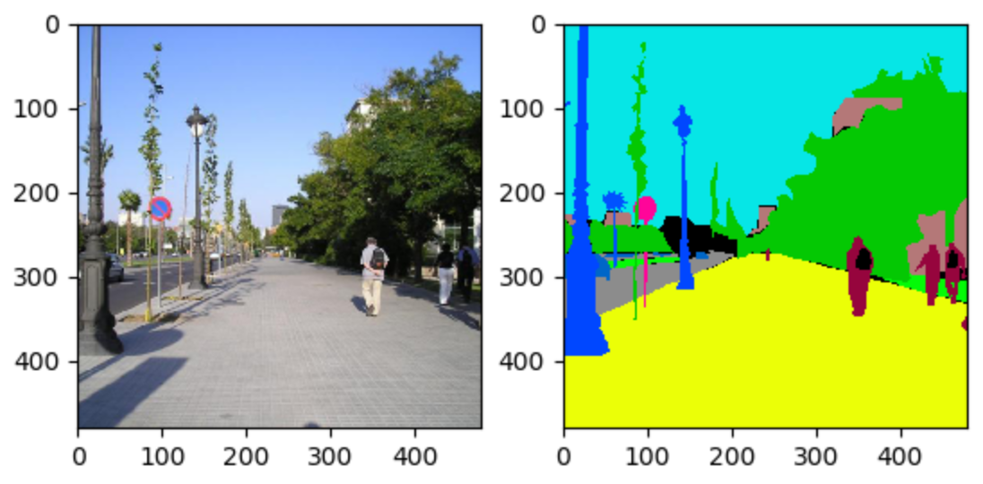
Dataset for Supervised Learning for each CV Task
Classification
Object Detection
Segmentation
Object Name with Bounding Box
Pixel level segmentation
Class

Slide 7
Public Vision Datasets
ADE20K : A scene-centric containing 20 thousands images annotated with 150 object categories
COCO : Large-scale object detection, segmentation, and captioning dataset
PASCAL VOC : A Collection of datasets for object detection
ImageNet : Millions of images and thousands of objects for image classification

Slide 8
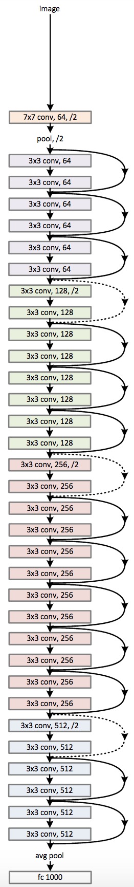
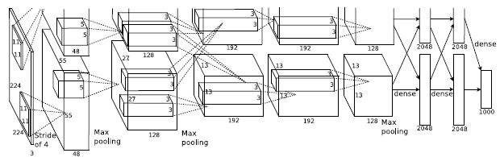


ML Algorithms. You are not alone

Slide 9
But ...
Re-implementation of papers with the same accuracy is not easy task
There are open source implementation, but
Quality of open source or 3rd party implementation of papers varies a lot
A lot of details vary from one implementation to another
Implementations focus on a single task applying only to a particular data set
Stopped support on the code

Slide 10
Introducing GluonCV
Our ML Experts created a Computer Vision toolkit using Gluon to solve these problems
for
Experienced users and Newcomers to CV field

Slide 11
Gluon CV Toolkit https://gluon-cv.mxnet.io/index.html
GluonCV provides implementations of the state-of-the-art (SOTA) deep learning models in computer vision.
It is designed for engineers, researchers, and students to fast prototype products and research ideas based on these models. This toolkit offers four main features:
Training scripts to reproduce SOTA results reported in research papers
A large number of pre-trained models
Carefully designed APIs that greatly reduce the implementation complexity
Community supports

Slide 12
Gluon CV Toolkit – Model Zoo https://gluon-cv.mxnet.io/model_zoo/index.html
Image Classification – CIFAR, ImageNet
ResNet V1, V2
WideResNet
Object Detection
SSD
Faster RCNN
Semantic Segmentation
FCN
PSPNet
from gluoncv import model_zoo
# load a ResNet model trained on CIFAR10
cifar_resnet20 = model_zoo.get_model('cifar_resnet20_v1', pretrained=True)
# load a pre-trained ssd model
ssd0 = model_zoo.get_model('ssd_300_vgg16_atrous_voc', pretrained=True)
# load ssd model with pre-trained feature extractors
ssd1 = model_zoo.get_model('ssd_512_vgg16_atrous_voc', pretrained_base=True)
# load ssd model without initialization
ssd2 = model_zoo.get_model('ssd_512_resnet50_v1_voc', pretrained_base=False)
cifar_resnet20 = model_zoo.cifar_resnet20_v1(pretrained=True)

Slide 13
What’s included
Reimplementation of important papers in recent years
Detailed documentation and well-documented examples
Pre-trained models that can be used directly
Performance metrics, to help choose between different models
Consistent interface to reduce the barrier to entry when switching from one model to another
Regular re-training and continuous integration to ensure code correctness

Slide 14
Let’s Install – On Your Own PC
1. Install mxnet, gluoncv and jupyter
pip install –-upgrade pip
pip install --pre mxnet
pip install gluoncv
pip install jupyter
2. Run jupyter notebook
jupyter notebook
3. Create a new notebook by “New” > ”Python*”
4. Verify if GluonCV is installed by importing it
import gluoncv

Slide 15
Let’s Install – On SageMaker
Create Notebook instance, and Open it
Create a new notebook by “New” > ”conda_mxnet_p36”
Execute the commands in a Code cell
!pip install --pre mxnet
!pip install gluoncv
Verify if GluonCV is installed by importing it
import gluoncv

Slide 16
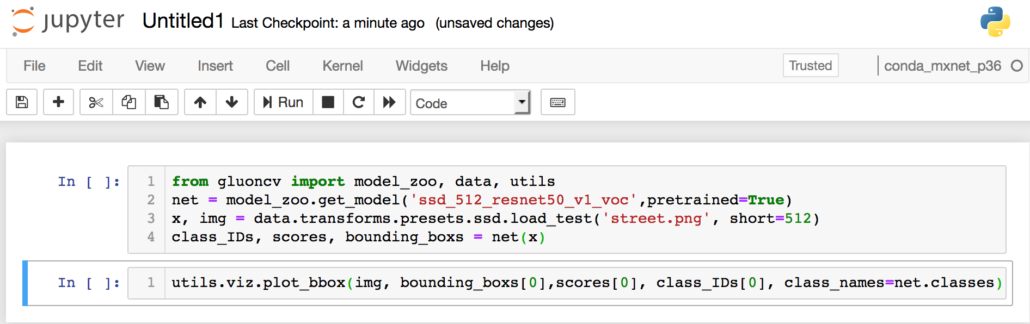
Your 1st Deep Learning Computer Vision Task
Find any street image on Internet, and Upload it to your notebook
Put the below code into two cells and Run them

Slide 17
Closer Look at the Code
importing necessary modules
from gluoncv import model_zoo, data, utils
net = model_zoo.get_model('ssd_512_resnet50_v1_voc',pretrained=True)
x, img = data.transforms.presets.ssd.load_test('street.jpg', short=512)
class_IDs, scores, bounding_boxs = net(x)
utils.viz.plot_bbox(img, bounding_boxs[0], scores[0], class_IDs[0], class_names=net.classes)

Slide 18
Closer Look at the Code
importing necessary modules
from gluoncv import model_zoo, data, utils
net = model_zoo.get_model('ssd_512_resnet50_v1_voc’, pretrained=True)
x, img = data.transforms.presets.ssd.load_test('street.jpg', short=512)
class_IDs, scores, bounding_boxs = net(x)
utils.viz.plot_bbox(img, bounding_boxs[0], scores[0], class_IDs[0], class_names=net.classes)
Loading pre-trained Object Detection Model

Slide 19
Closer Look at the Code
importing necessary modules
from gluoncv import model_zoo, data, utils
net = model_zoo.get_model('ssd_512_resnet50_v1_voc’, pretrained=True)
x, img = data.transforms.presets.ssd.load_test('street.jpg', short=512)
class_IDs, scores, bounding_boxs = net(x)
utils.viz.plot_bbox(img, bounding_boxs[0], scores[0], class_IDs[0], class_names=net.classes)
Loading pre-trained Object Detection Model
Loading an image, and Transforming it to tensor by applying normalizations

Slide 20
Closer Look at the Code
importing necessary modules
from gluoncv import model_zoo, data, utils
net = model_zoo.get_model('ssd_512_resnet50_v1_voc’, pretrained=True)
x, img = data.transforms.presets.ssd.load_test('street.jpg', short=512)
class_IDs, scores, bounding_boxs = net(x)
utils.viz.plot_bbox(img, bounding_boxs[0], scores[0], class_IDs[0], class_names=net.classes)
Loading pre-trained Object Detection Model
Loading an image, and Transforming it to tensor by applying normalizations
Inferencing on the image

Slide 21
Closer Look at the Code
importing necessary modules
from gluoncv import model_zoo, data, utils
net = model_zoo.get_model('ssd_512_resnet50_v1_voc’, pretrained=True)
x, img = data.transforms.presets.ssd.load_test('street.jpg', short=512)
class_IDs, scores, bounding_boxs = net(x)
utils.viz.plot_bbox(img, bounding_boxs[0], scores[0], class_IDs[0], class_names=net.classes)
Loading pre-trained Object Detection Model
Loading an image, and Transforming it to tensor by applying normalizations
Inferencing on the image
Visualizing the result with bounding box

Slide 22
How to load a model
Loading a model by name
gluoncv.model_zoo.get_model
gluoncv.model_zoo.get_[model name]
Loading a model directly from Gluon Model Zoo
from mxnet.gluon.model_zoo import vision
resnet18 = vision.resnet18_v1()

Slide 23
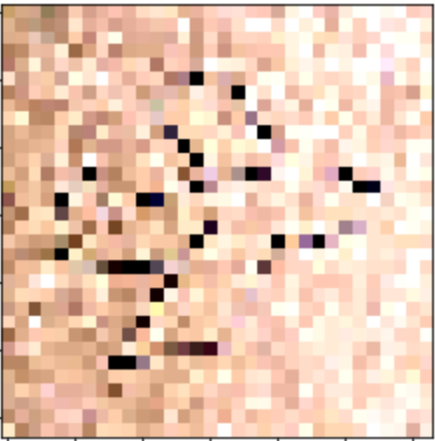
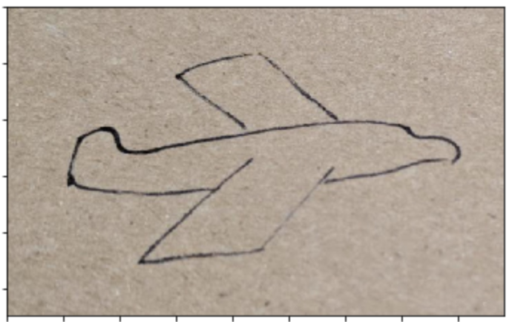
How to load images for inference
plan-draw.jpg
img = image.imread(im_fname)
img.expand_dims(axis=0)
IMAGE FILE READ
TRANSFORM
DIMENSION
EXPANSION
INPUT
(548,882,3)
(3,32,32)
(1,3,32,32)
transform_fn = transforms.Compose([
transforms.Resize(32),
transforms.CenterCrop(32),
transforms.ToTensor(),
transforms.Normalize(
[0.4914, 0.4822, 0.4465], [0.2023, 0.1994, 0.2010])
])
AIRPLAN (99%)

Slide 24
How to load images for inference
plan-draw.jpg
IMAGE FILE READ
TRANSFORM
DIMENSION
EXPANSION
INPUT
(548,882,3)
(3,32,32)
(1,3,32,32)
Channel First
batch size
AIRPLAN (99%)

Slide 25
Lab 1: Inference on Image
!wget https://gluon-cv.mxnet.io/_downloads/demo_cifar10.ipynb

Slide 26
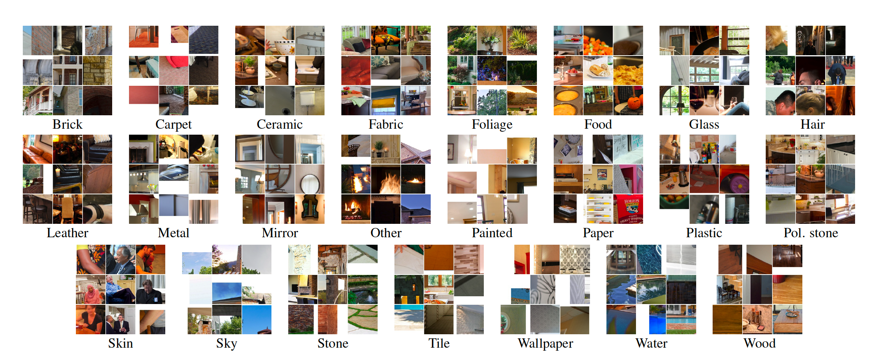
You have your own image dataset for classification
MINC (Materials in Context Database) by Cornell
MINC-2500 with 23 classes and 2500 images

Slide 27
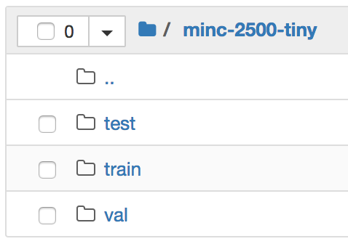
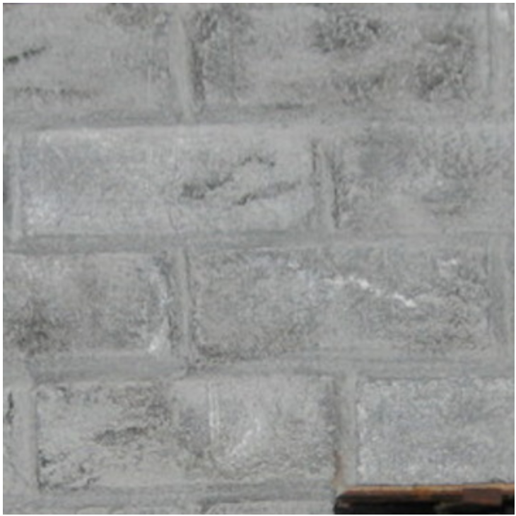
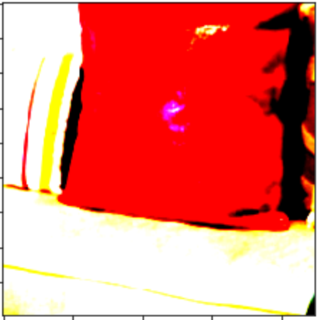
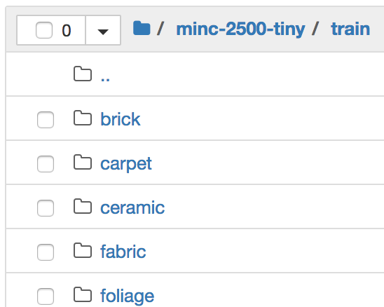
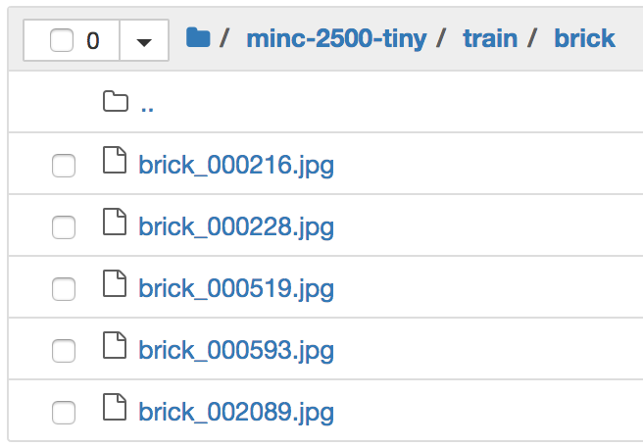
How to load Training Data using DataLoader
FILES
DataLoader
Mini-Batch
N * (362,362,3)
(N, 3, 224, 224)
(B, 3, 224, 224)
transform_train = transforms.Compose([
transforms.RandomResizedCrop(224),
transforms.RandomFlipLeftRight(),
transforms.RandomColorJitter(brightness=jitter_param, contrast=jitter_param,
saturation=jitter_param),
transforms.RandomLighting(lighting_param),
transforms.ToTensor(),
transforms.Normalize([0.485, 0.456, 0.406], [0.229, 0.224, 0.225])
])
train_data = gluon.data.DataLoader(
gluon.data.vision.ImageFolderDataset(train_path).transform_first(transform_train),
batch_size=batch_size, shuffle=True, num_workers=num_workers)

Slide 28
Lab 2: Image Dataset for Training
!wget https://gluon-cv.mxnet.io/_downloads/transfer_learning_minc.ipynb
If you don’t have a GPU, set num_gpus from 1 to 0
Set batch_size = 32
Finish up through ”Data Augmentation” cell
Take a look at directories and files under ./minc-2500-tiny

Slide 29
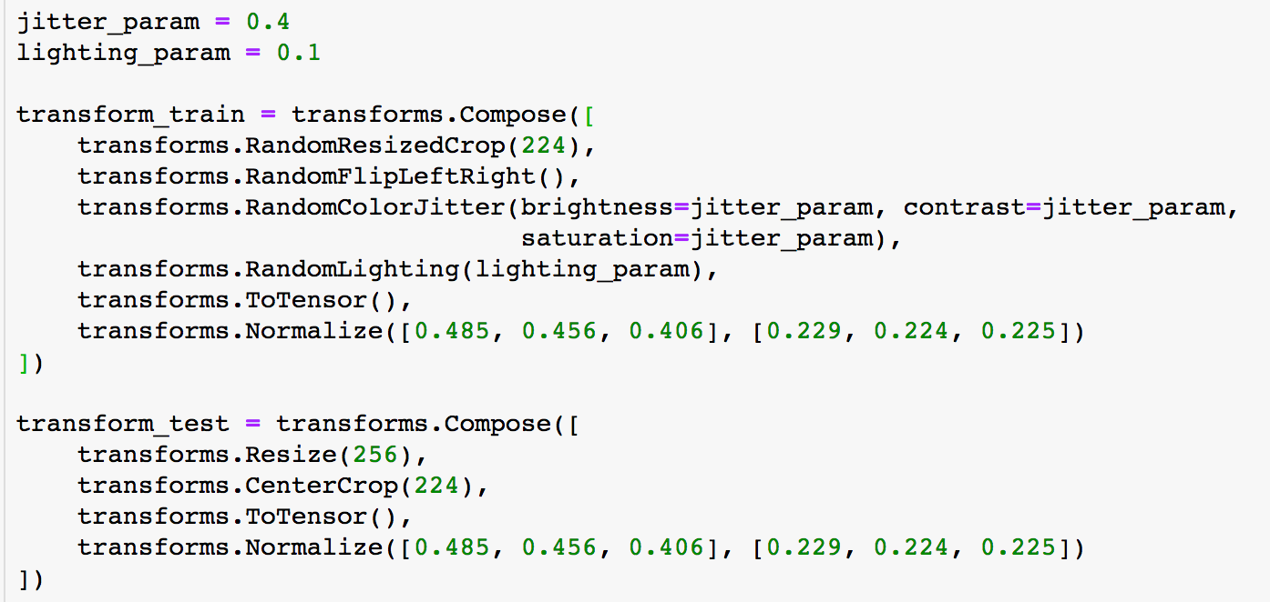
Quiz
Why are Train Transform and Test Transform different?

Slide 30
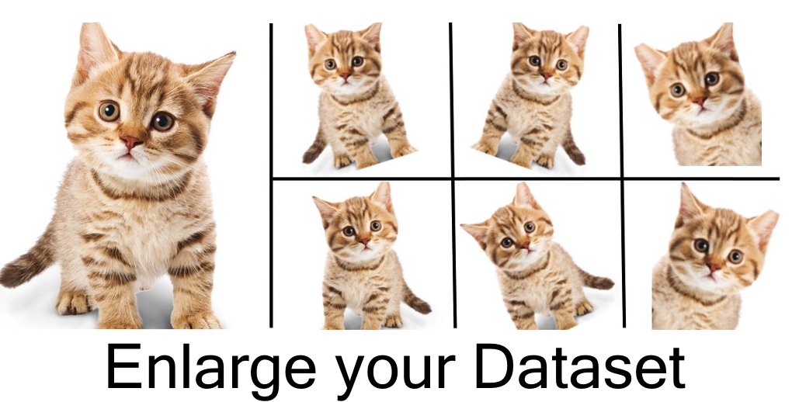
Data Augmentation for training on small set of data https://medium.com/nanonets/how-to-use-deep-learning-when-you-have-limited-data-part-2-data-augmentation-c26971dc8ced

Slide 31



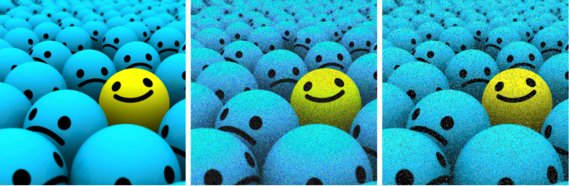

Data Augmentation for training on small set of data https://medium.com/nanonets/how-to-use-deep-learning-when-you-have-limited-data-part-2-data-augmentation-c26971dc8ced
Flip
Rotation
Crop
Gaussian Noise
Scale

Slide 32
Data Augmentation API in Gluon https://mxnet.incubator.apache.org/api/python/gluon/data.html https://mxnet.incubator.apache.org/tutorials/gluon/data_augmentation.html
RandomResizedCrop | Crop the input image with random scale and aspect ratio.
CenterCrop | Crops the image src to the given size by trimming on all four sides and preserving the center of the image.
RandomFlipLeftRight | Randomly flip the input image left to right with a probability of 0.5.
RandomFlipTopBottom | Randomly flip the input image top to bottom with a probability of 0.5.
RandomBrightness | Randomly jitters image brightness with a factor chosen from [max(0, 1 - brightness), 1 + brightness].
RandomContrast | Randomly jitters image contrast with a factor chosen from [max(0, 1 - contrast), 1 + contrast].
RandomSaturation | Randomly jitters image saturation with a factor chosen from [max(0, 1 - saturation), 1 + saturation].
RandomHue | Randomly jitters image hue with a factor chosen from [max(0, 1 - hue), 1 + hue].
RandomColorJitter | Randomly jitters the brightness, contrast, saturation, and hue of an image.
RandomLighting | Add AlexNet-style PCA-based noise to an image.

Slide 33
How to apply data augmentation in Gluon
from mxnet.gluon.data.vision import MNIST, transform
from mxnet import gluon
transform = transforms.Compose([
transforms.Resize(300),
transforms.RandomResizedCrop(224), transforms.RandomBrightness(0.1),
transforms.ToTensor(),
transforms.Normalize(0, 1)])
data = MNIST(train=True).transform_first(transform)
data_loader = gluon.data.DataLoader(data, batch_size=32, num_workers=1)
for data, label in data_loader:
# do something with data and label

Slide 34
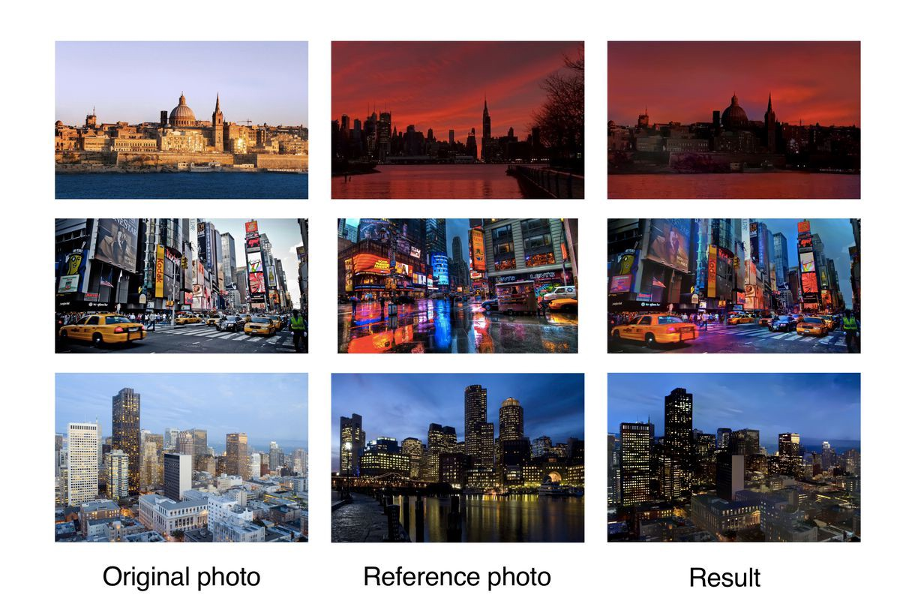
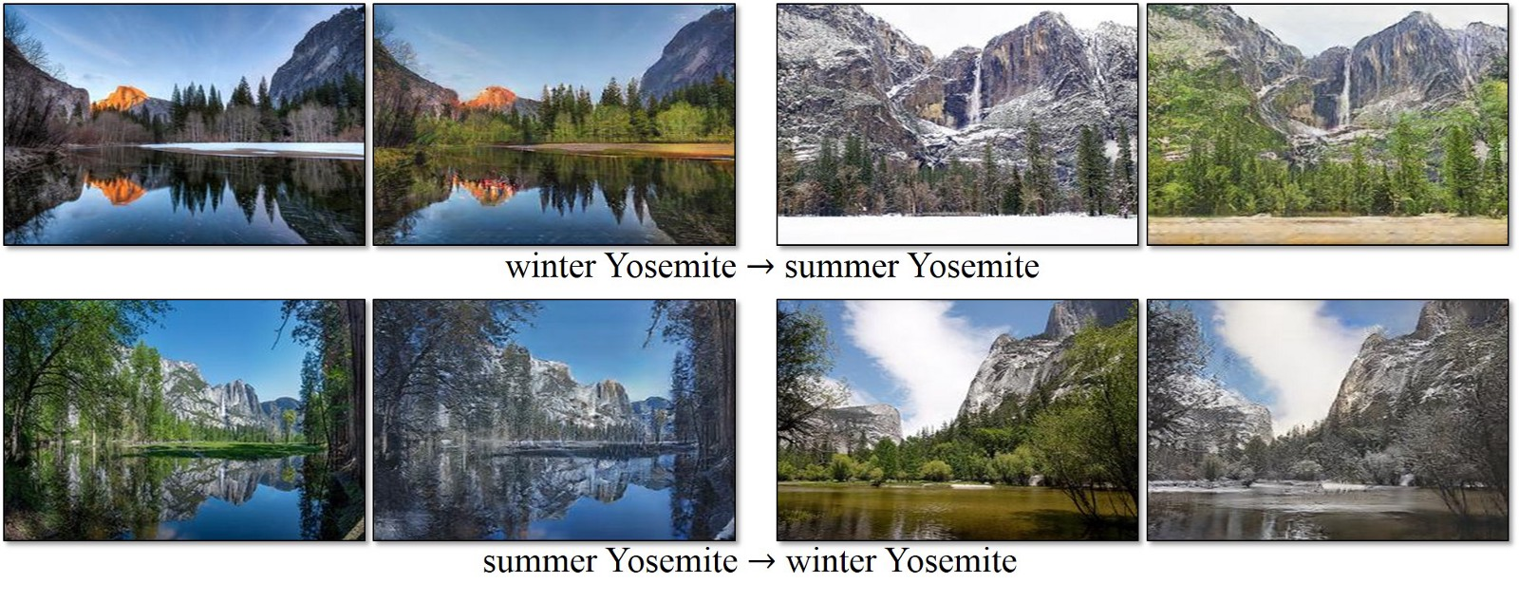
Advanced Data Augmentation Method
Neural Style Transfer
CycleGAN to change seasons of scene
Image Credit: https://medium.com/nanonets/how-to-use-deep-learning-when-you-have-limited-data-part-2-data-augmentation-c26971dc8ced

Slide 35
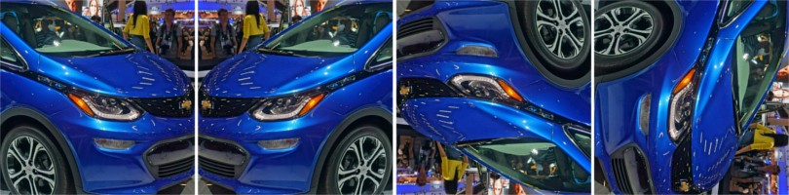
Quiz: Which augmented images are meaningful?
1
2
3
Original Image

Slide 36
Full Training vs. Transfer Learning http://cs231n.github.io/transfer-learning/
Full Training: Learning only from your training data
Transfer Learning: Learning from your training data up on the pre-trained model (weights)
ConvNet as fixed feature extractor
Fine-tuning the ConvNet
SVM
Logistic Regression
DNN
Feature Extractor
Classifier

Slide 37
Transfer Learning – Fine Tuning
Load the pre-trained model
model_name = 'ResNet50_v2'
finetune_net = gluon.model_zoo.vision.get_model(model_name, pretrained=True)
Re-define the output layer for the new task
with finetune_net.name_scope():
finetune_net.output = nn.Dense(classes)
finetune_net.output.initialize(init.Xavier(), ctx=ctx)
finetune_net.collect_params().reset_ctx(ctx)
Train the network

Slide 38
Lab 3: Transfer Learning
!wget https://gluon-cv.mxnet.io/_downloads/transfer_learning_minc.ipynb
Resume where you are done in the previous lab
If your notebook instance is not of P2 or P3,
set ‘batch_size’ to 32 explicitly.

Slide 39
File IO can be a performance blocker if
Training data is composed of tons of raw image files

Slide 40
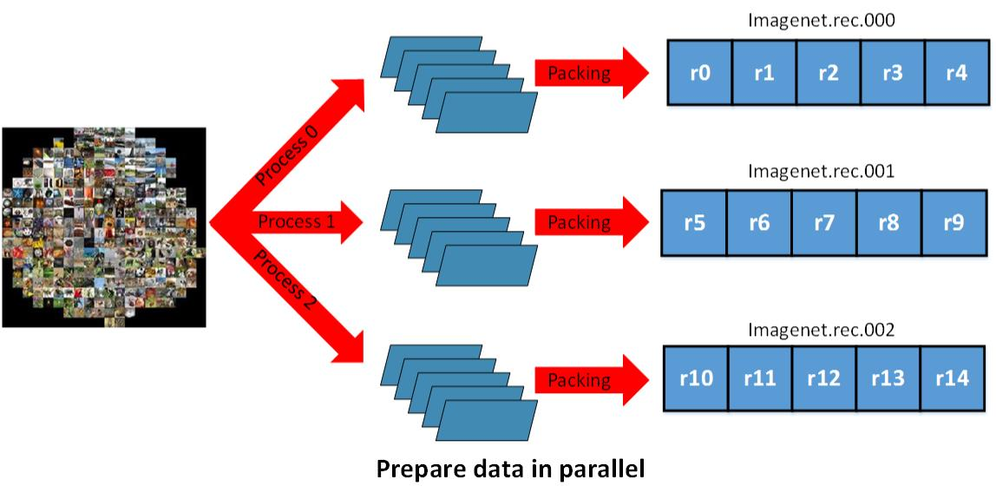
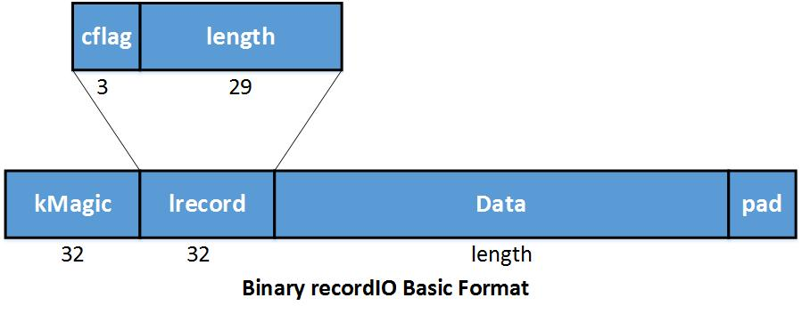
ImageRecord format for your dataset http://mxnet.incubator.apache.org/architecture/note_data_loading.html
Small file size.
Parallel (distributed) packing of data.
Fast data loading and online augmentation.
Quick reads from arbitrary parts of the dataset in the distributed setting

Slide 41
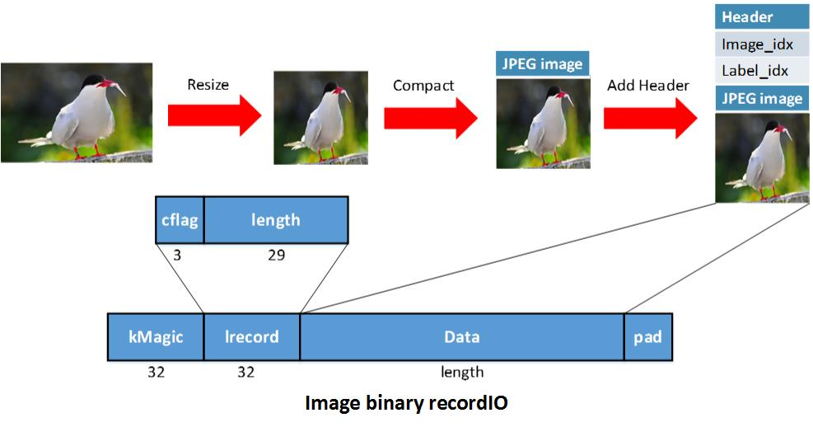
Image RecordIO Format

Slide 42
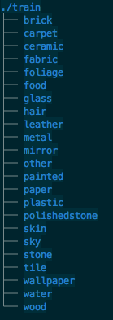
Lab 4 : Creating RecordIO Files https://gluon-cv.mxnet.io/build/examples_datasets/recordio.html
Use image files created in Lab 2 (DO NOT TRY TO DOWNLOAD ImageNet files)
Download im2rec.py from http://bit.ly/2vHlHLh, and install opencv-python
pip install opencv-python
Step 1. Generate a .lst file
python im2rec.py ./train_rec ./train/ --recursive --list --num-thread 8
Step 2. Generate a .idx and .rec files
python im2rec.py ./train_rec ./train/ --recursive
--pass-through --pack-label --num-thread 8
Notes:
Mxnet
Opencv-python

Slide 43
Lab 4 : Creating RecordIO Files https://gluon-cv.mxnet.io/build/examples_datasets/recordio.html
!wget https://gluon-cv.mxnet.io/_downloads/recordio.ipynb
In Jupyter notebook, read .rec and .idx file and visualize samples
by following cells of “Read with GluonCV” section

Slide 44
END OF GluonCV

